Slide 1
2018-2019
SPLIT SECOND 101 – Data Management of an Alpine Event
Prepared for use in conjunction with:
Race Administration Study Guide Section 1 –
Race Result Software

Slide 2
CHOICE OF SOFTWARE
There are two vendors who provide software capable of producing documents and results in the formats required by U.S. Ski & Snowboard and FIS.
This presentation is for Organizing Committees using:
NATIONAL/FIS Software (Split Second)

Slide 3
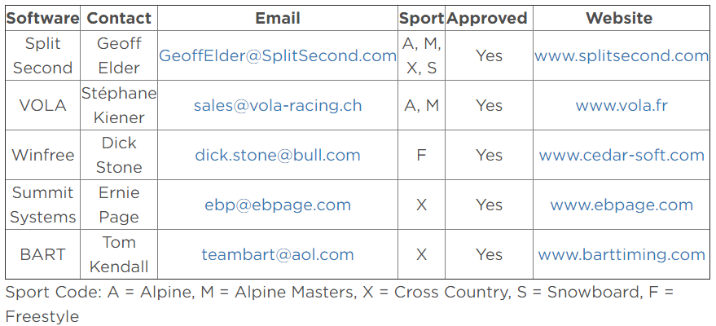
RACE RESULT SOFTWARE
usskiandsnowboard.org/sport-development/officials-development/timing-race-administration
Access splitsecond.com or vola.fr/en/timing/logiciels/suite-skialp

Slide 4
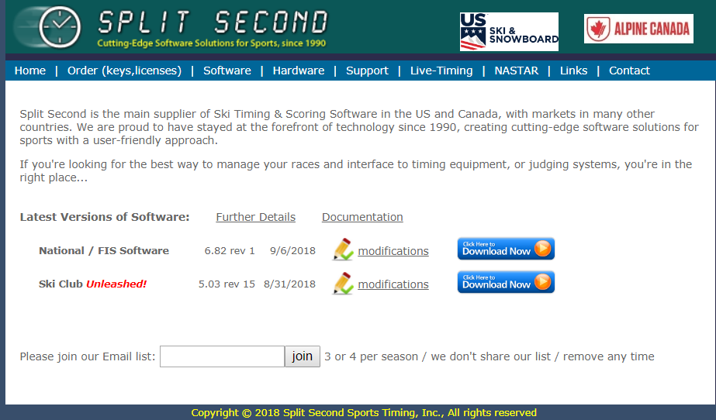
SELECT LINK ON U.S. SKI & SNOWBOARD WEBSITE: usskiandsnowboard.org
Begin download
National/FIS Software can be used for Alpine, Snowboard, Cross Country, & Masters & events and is the focus of this presentation.
Ski-Club Unleashed! offers result processing for duals, etc., and is not addressed in this presentation.

Slide 5
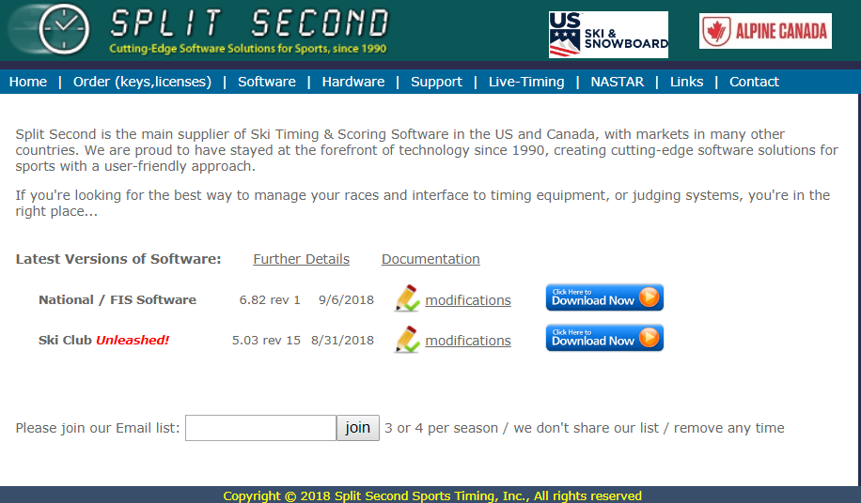
INFORMATION & DOWNLOAD PAGE
Begin download
And Monitor download
Note: Installation on a company computer may require IT assistance.

Slide 6
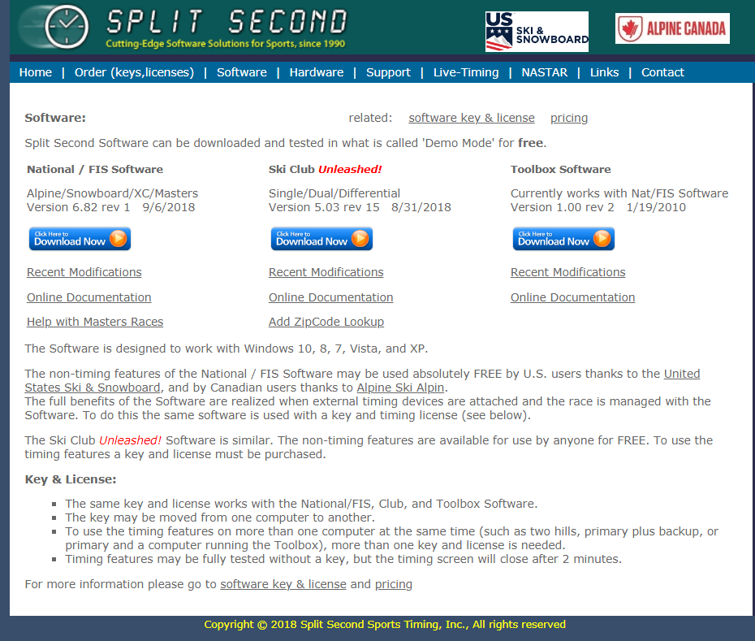
SELECT “SOFTWARE”
Select “Software”: review recent modifications and Download

Slide 7
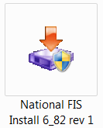
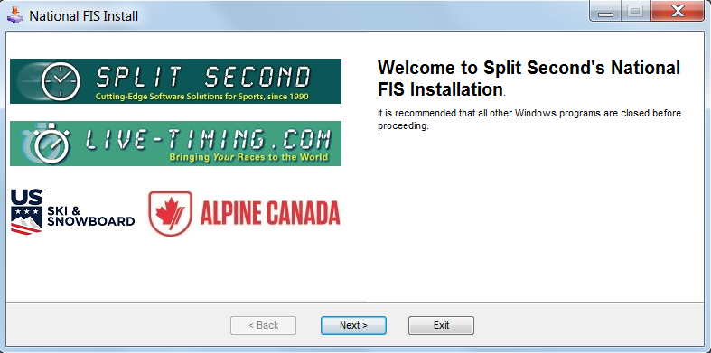
SOFTWARE INSTALLATION
Depending on your storage location for downloaded files, you will find an executable file in a similar format.
Click to begin installation.
Select “Next” & Begin Installation

Slide 8
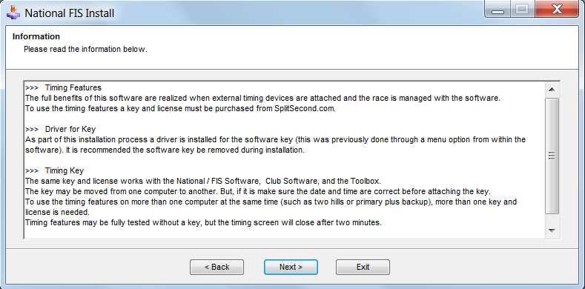
INFORMATION: Review & Select “NEXT”

Slide 9
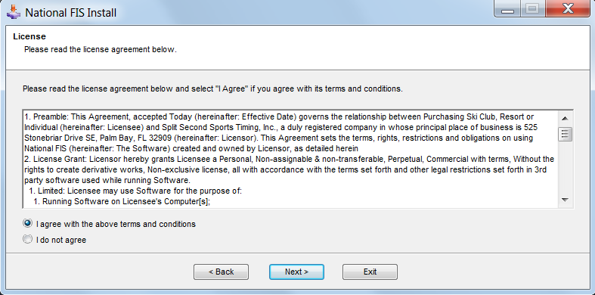
LICENSING AGREEMENT Agree & Select “NEXT”

Slide 10
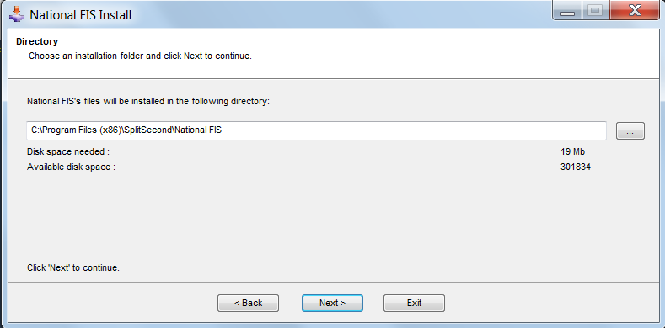
VERIFY or CHANGE STORAGE LOCATION: Select “NEXT”

Slide 11
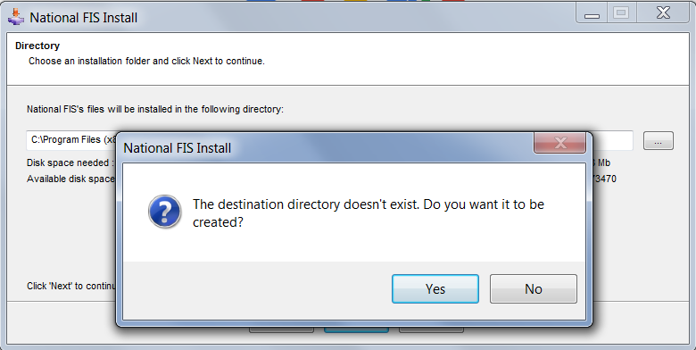
FIRST-TIME INSTALLATION? Select “YES”

Slide 12
SELECT “START” TO INSTALL

Slide 13
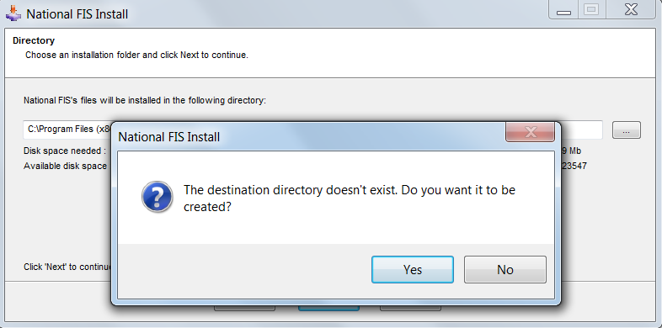
SELECT “YES” TO CREATE DIRECTORY AND CONTINUE INSTALLATION

Slide 14
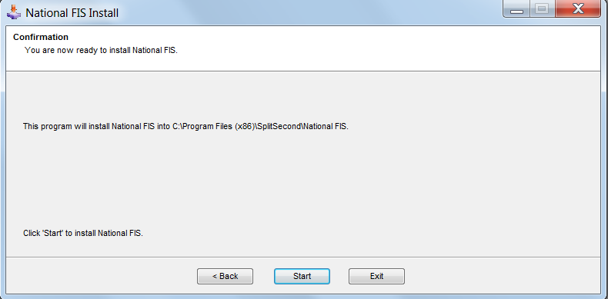
SELECT “START” TO INSTALL

Slide 15
KEY REQUIRED?
You must select either: “Yes” or “No”
Key is required for computers linked to external timing device(s). If you are only preparing race files and printing documents, you do not have to install the key driver. (Key requires payment of a fee.)

Slide 16
IF “YES” is SELECTED

Slide 17
IF “NO” is SELECTED
ALL DONE: Select “EXIT”

Slide 18
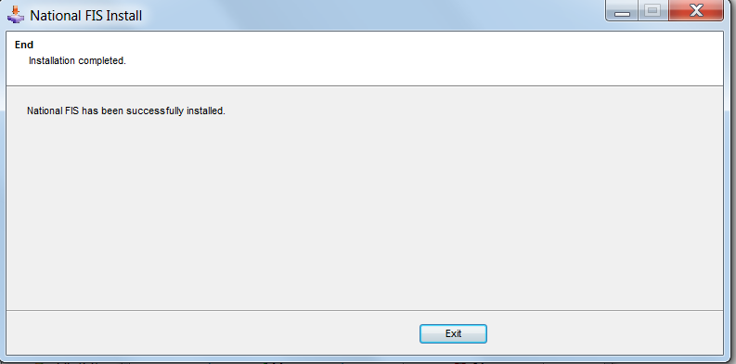
INSTALLATION COMPLETE. SELECT “EXIT” TO CONTINUE

Slide 19
ICON ON YOUR DESKTOP (Shortcut)
Click icon to start the software.

Slide 20
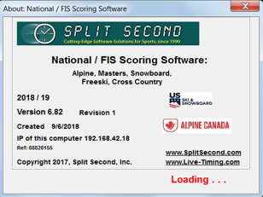
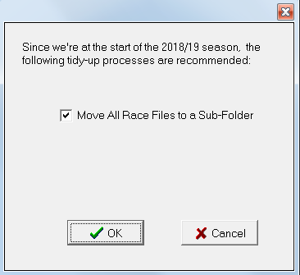
OPENING SCREENS
Year 2018/19 is required for current season.
Note Version #, Revision # and creation date.
Select “OK” and continue

Slide 21
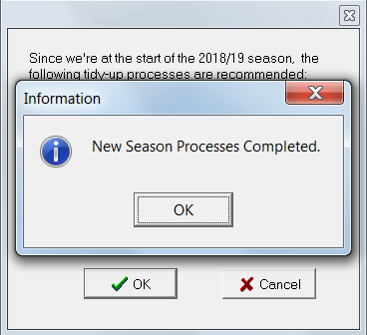
Welcome to Season 2019
Select “OK”

Slide 22
CHANGE NOTICES
This is the screen you will see if you already have Split Second installed on your computer and open the software for use prior to installation of a new season’s version.
During the season, this screen will be used to notify users of version updates.
If a new version is available, changes will be listed and user will be given option to either
accept or reject the download.

Slide 23
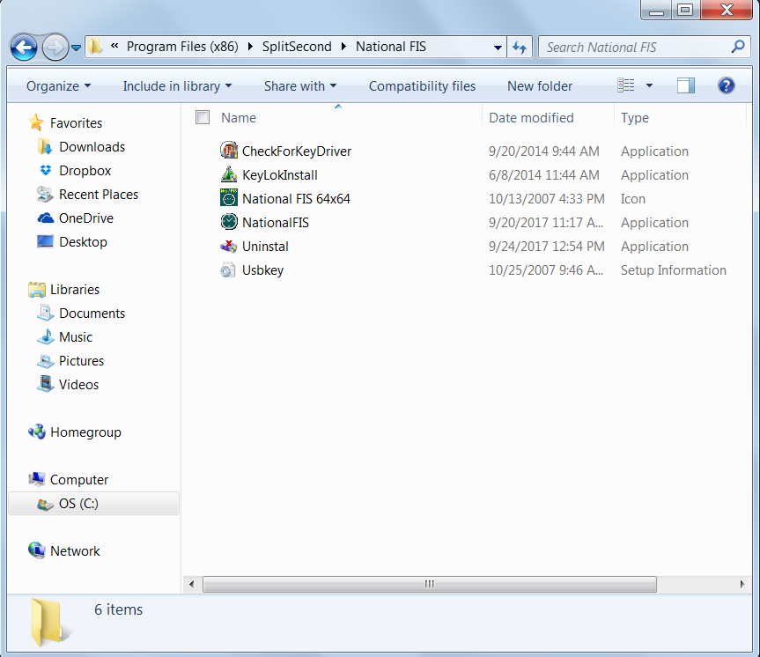
SOFTWARE
Notice actual location of software and related files.
It is different than the location of the “working files”.

Slide 24
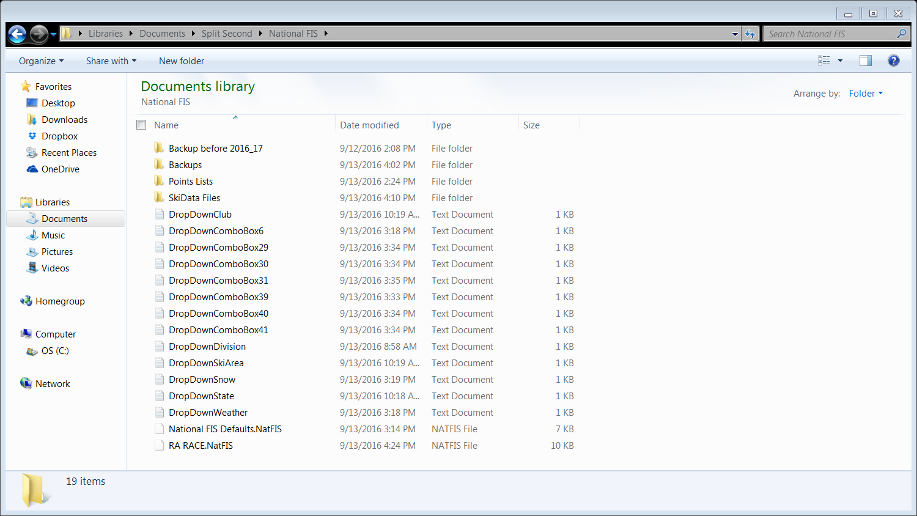
CONTENTS OF SOFTWARE
Notice location of “working files”…it is different than that of the software.
Drop Down boxes will be auto-deleted on installation.
It is recommended that all Drop Down Box(es) be regularly deleted.

Slide 25
SET YOUR DEFAULTS
If this screen does not appear, “Defaults” can be accessed by selecting “EDIT”
Select “DEFAULTS”
Data entered in “Defaults” is used to create ALL your races.

Slide 26
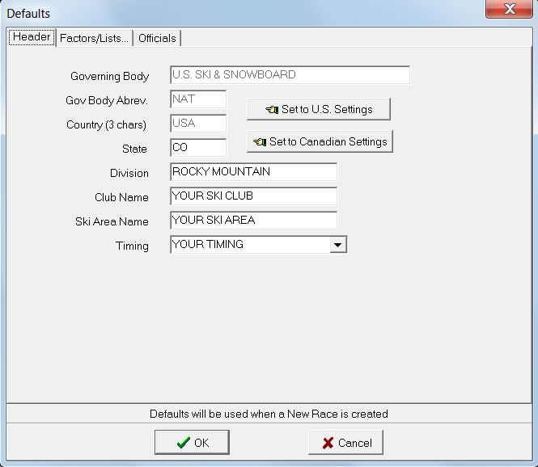
SET “HEADER” DEFAULTS
Only used to change nation where event is staged
State
Division
Club Name
Ski Area Name
Timing Equipment or
Timing Company Name
Select “OK” to continue

Slide 27
DEFAULTS: “FACTORS/LISTS”
Verify your defaults, e.g. Factors/Max Seed Points at the beginning of every season. Category Adders may change; Points Lists will change.

Slide 28
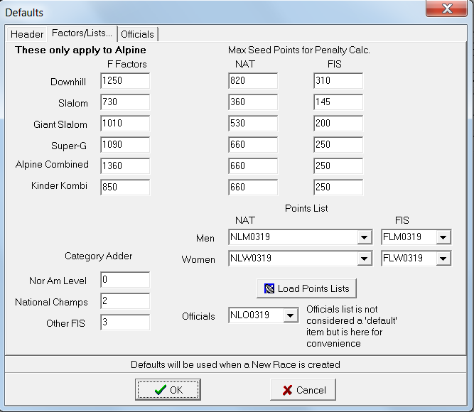
POINTS LISTS - Defaults
Using the “default” page to load Points Lists.
(Must be online to use this option!)

Slide 29
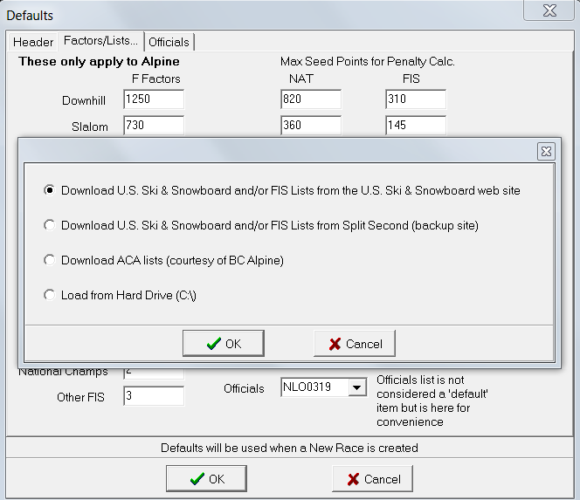
OPTIONS: LOADING POINTS LISTS
U.S. Ski & Snowboard website
Split Second backup location
ACA = Canadian Points for Canadian events
Load lists saved to hard drive
Make selection and click “OK”

Slide 30
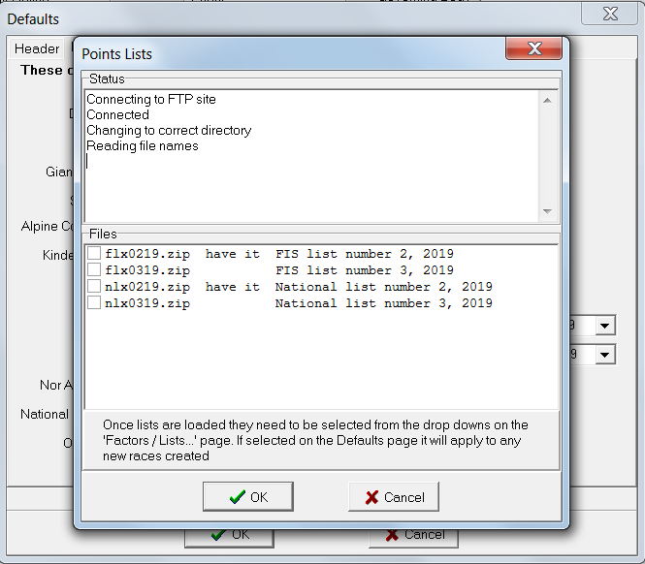
ONLINE OPTION
Software connects to U.S. Ski & Snowboard FTP site for retrieval and download.

Slide 31
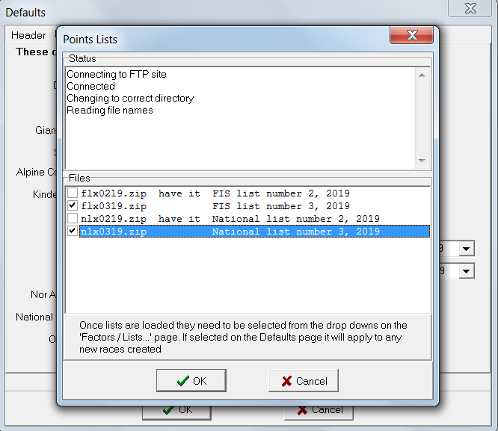
MAKE YOUR SELECTION(S) (Only 1 FIS & 1 National Loaded)
Make your selection (multiple selections possible). by clicking the box next to the appropriate list and selecting “OK” to continue.

Slide 32
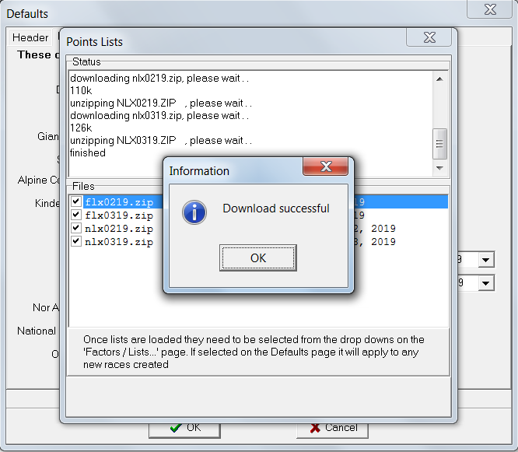
YOU ARE INFORMED OF PROGRESS
Select “OK” & continue.

Slide 33
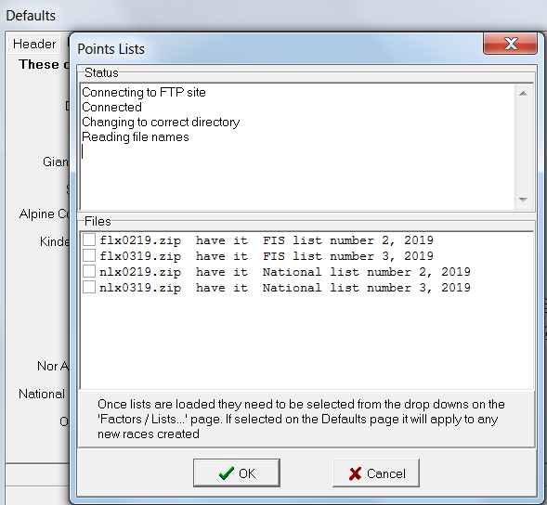
MAKE YOUR SELECTION(S) (Available lists loaded)
“HAVE IT” indicates what lists are already loaded!
Select “Cancel” to continue.

Slide 34
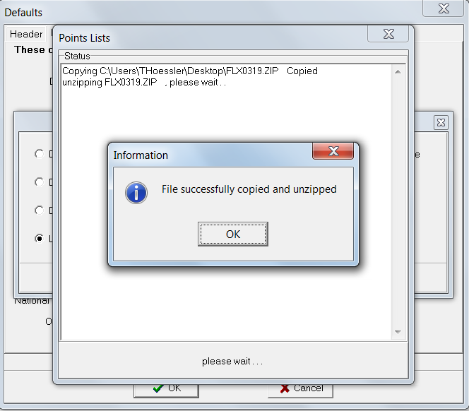
LOAD LISTS FROM HARD DRIVE
Lists available on U.S. Ski & Snowboard website; downloaded to hard drive and then loaded into software.

Slide 35
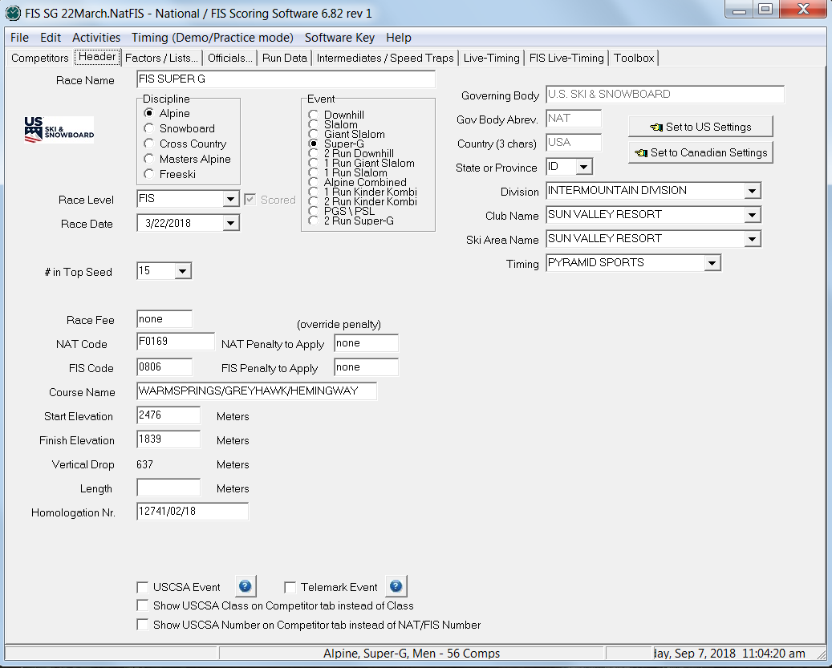
LOAD POINTS LISTS – “Activities”
Points lists can also
be loaded by selecting “Activities”
Process is same as that used by “Defaults”

Slide 36
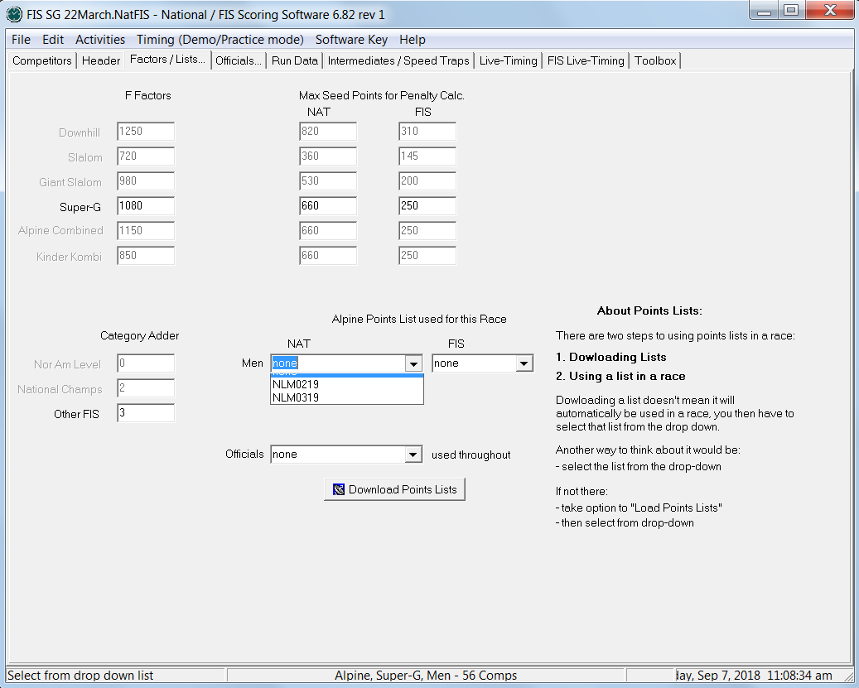
SELECT LISTS YOU NEED
Category Adders required only for FIS events
Listed on cover page of each FIS List.
Use the dropdown menus & select the lists you want to use: NLM = National Men; NLW = National Women; FLM = FIS Men; NLW = National Women; NLO = U.S. Ski & Snowboard member Officials

Slide 37
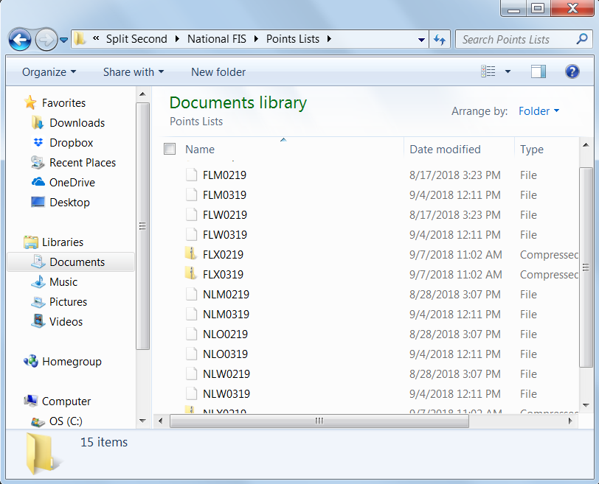
CONTENTS OF POINTS LIST PORTION OF SOFTWARE
Working Files – Points List: If you have to reload a list, delete all copies: M / W / Compressed (zipped) Folder.

Slide 38
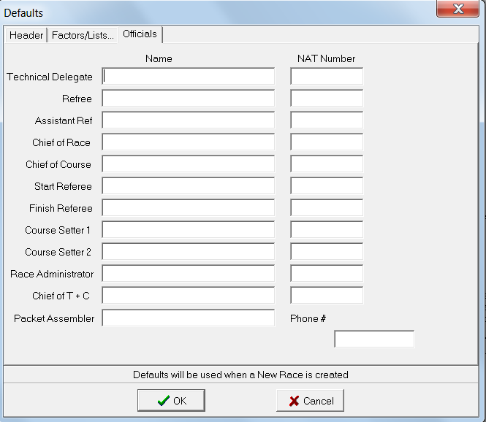
DEFAULTS: OFFICIALS
Use this option when using the same officials for all your events.

Slide 39
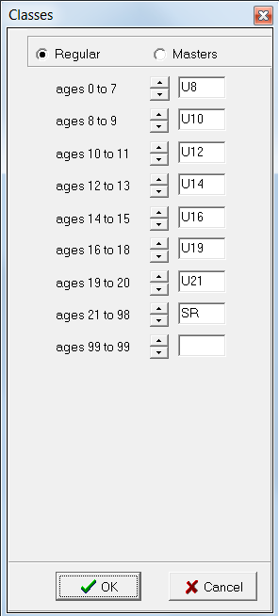
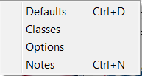
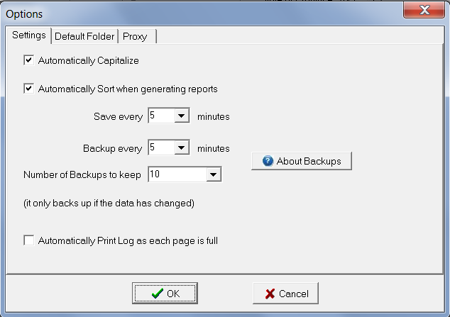
OTHER EDIT OPTIONS:

Slide 40
“EDIT”/”OPTIONS”: AUTO-SAVE
Set up “auto-save”/”backup” options but also backup your event(s) to an external drive or thumb drive. This should be done after any major data change, e.g. final/verified entries, start/bib # assignments, 1st run time entry, etc.

Slide 41
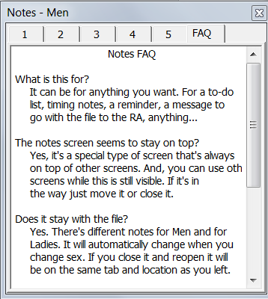
“EDIT” OPTION: NOTES
What is it? What is it for – FAQ?
This is a self-explanatory tool that will provide you with a set location for notes related to your event.

Slide 42
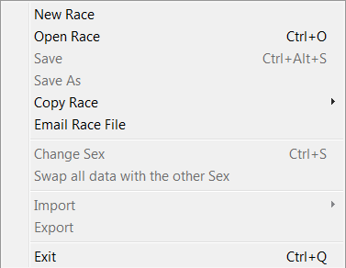
CREATING EVENT
Select “File”
Select “New Race”

Slide 43
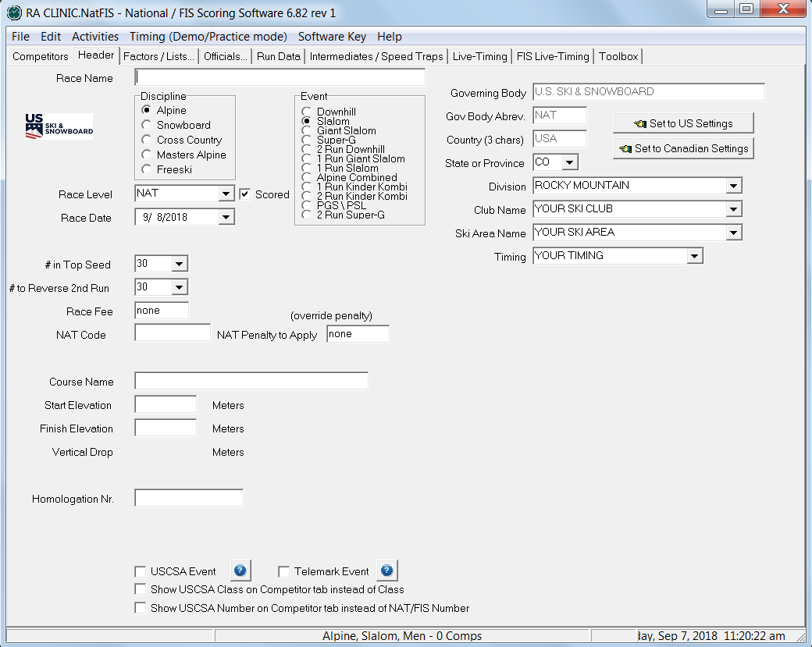
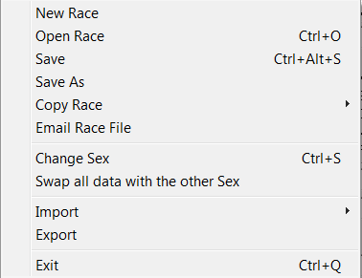
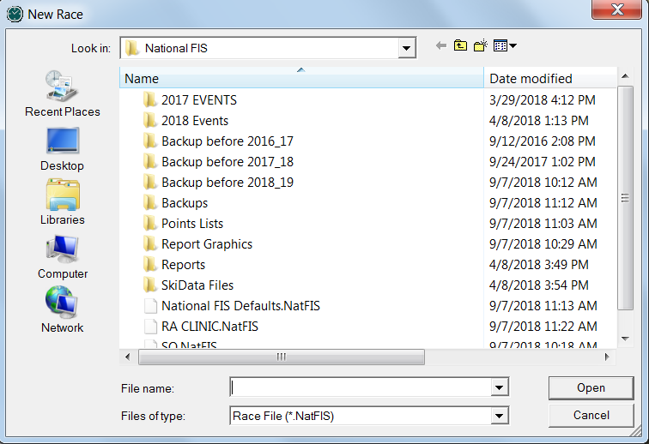
CREATE YOUR EVENT/RACE
Select “File” / “New” or “Open Race”
Create a file name that will be easily identified: e.g.: L_SL_31dec
Use same file name for L-T posting!
Notice “NatFIS” extension

Slide 44
DATA VERIFICATION
All entered data must be verified against the original data source:
U.S. Ski & Snowboard website for non-FIS event data and
FIS website for FIS event data
All computers involved in the timing/scoring/documentation of an event must be running the same software version
All computers involved in the timing/scoring/documentation of an event must have current Points Lists loaded because transferred race files only contain keyed data; they do not contain accessible copies of the Points Lists.
Identical data access is required if timing personnel have to make a change in the race file: e.g. insert a competitor, change an official.

Slide 45
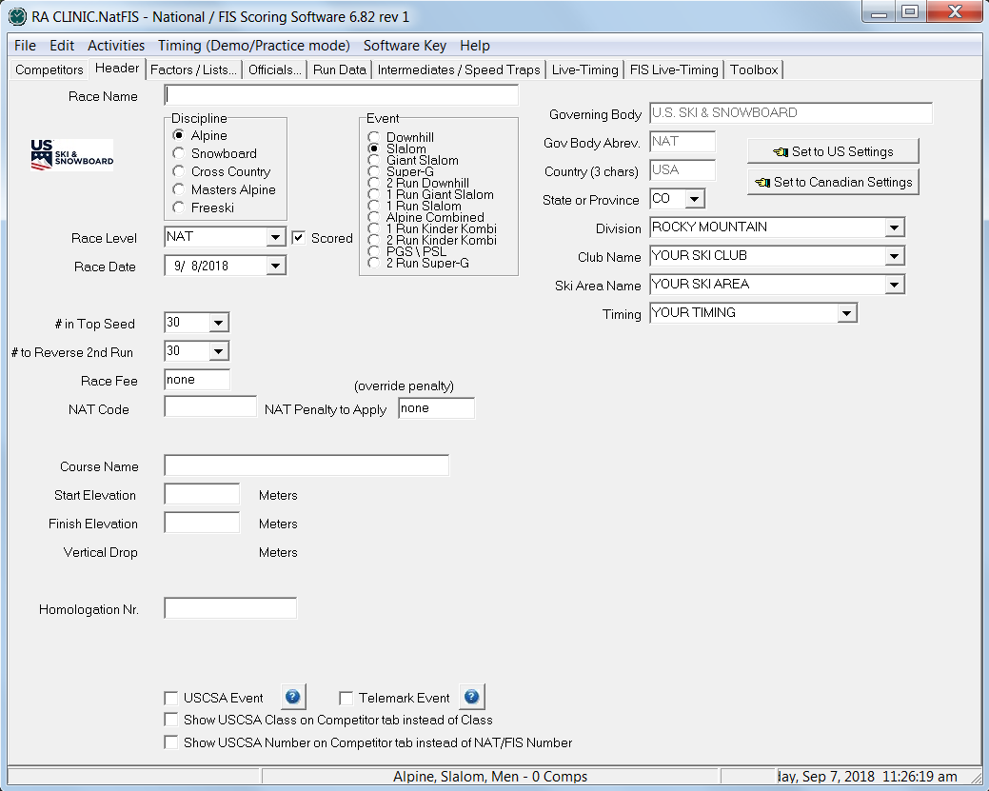
OPENING HEADER SCREEN: NON-FIS EVENT
Name of Race as noted on U.S. Ski & Snowboard*
State, Division, Club, Ski Area, Timing Equipment or Timing Co. Name
Non-FIS Race Level:
 = Scored uncheck for
= Non-Scored
Race Date
Course Name & Homologation No. as noted in Homologation Report.
Start & Finish Elevations as verified by the TD.
Use to override calculated Penalty
Non-FIS Code, an alpha+4-digit # for all non-FIS events including speed training as noted on website
When keying in data, use “TAB” (not “ENTER”) to exit data fields.
* Do not use an ampersand (&) even if included in noted name; code writing characters are not accepted by XML

Slide 46
OPENING HEADER SCREEN: FIS EVENT
Name of Race as noted on FIS & U.S. Ski & Snowboard website
State, Division, Club, Ski Area, Timing Equipment or Timing Co. Name
Select correct FIS Race Level
Race Date
Use to limit 2nd Run (e. g.: NAC)
Course Name & Homologation # as noted in Homologation Report.
Start & Finish Elevations as verified by the TD.
Non-FIS Code: alpha+4-digit # for non-FIS events as noted on U.S. Ski & Snowboard website
FIS Code: 4-digit # for all FIS events as noted on FIS website
Use to override calculated Penalty
When keying in data, use “TAB” (not “ENTER”) to exit data fields.

Slide 47
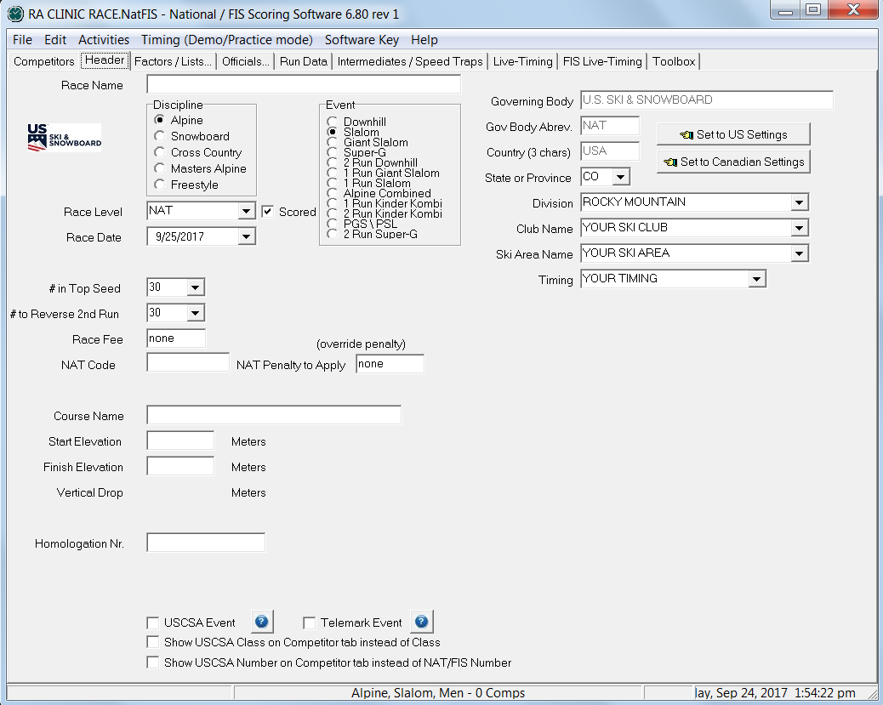
SELECT YOUR EVENT: Non-FIS or FIS
Your Discipline = ALPINE
Review options and select your event: DH, SL, GS, SG, etc.

Slide 48
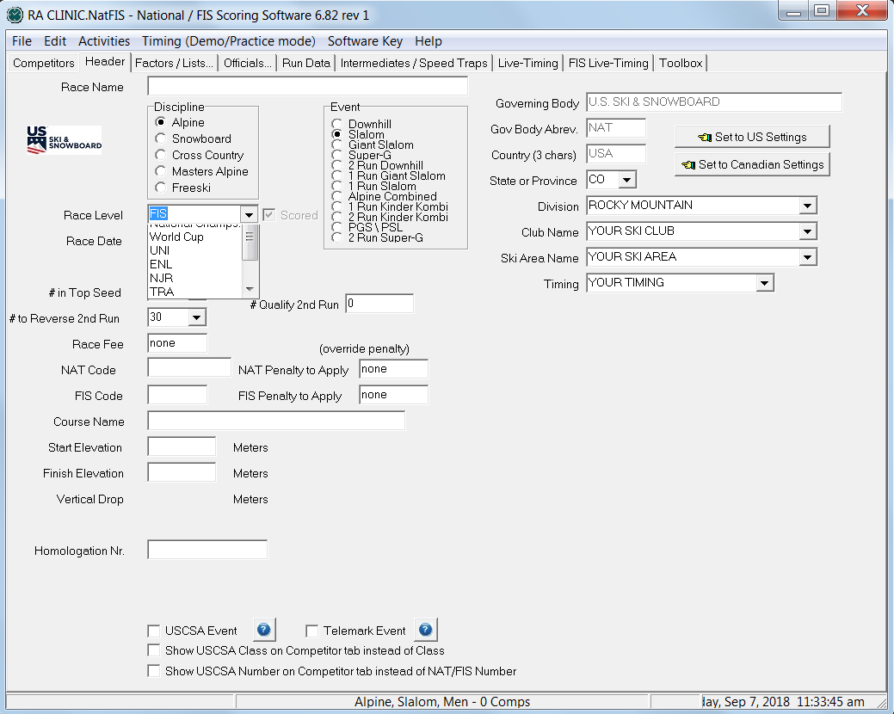
FIS RACE LEVELS
After setting to “FIS”, select correct “Race Level” as noted on FIS website

Slide 49
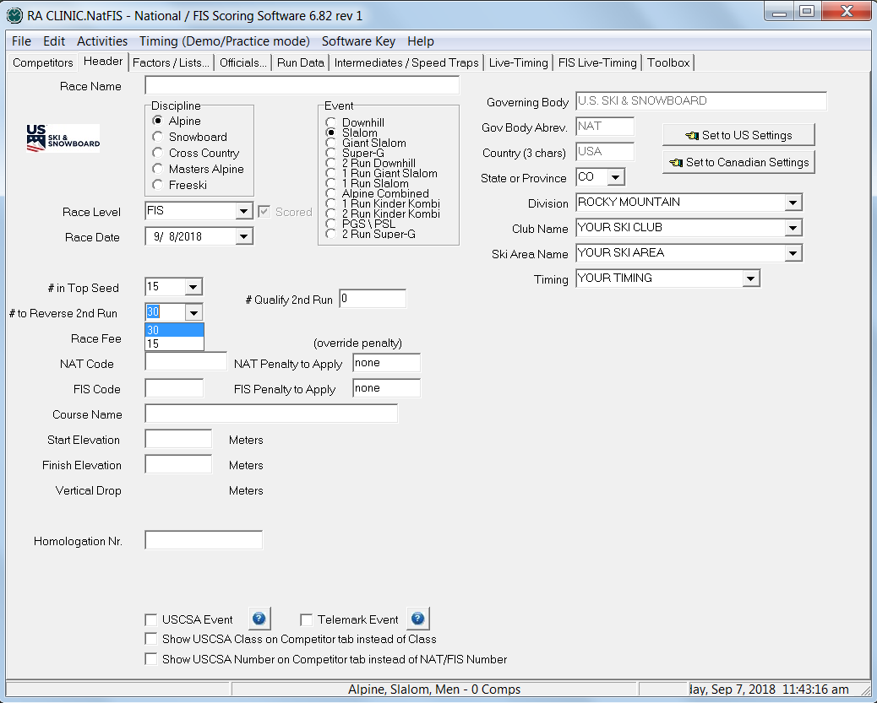
# in Top Seed & # Qualify 2nd Run
1.)
3.)*
2.)
1.) How many racers are in the first/top seed (lowest point holders) of scored event;
how many will be sorted in computer-assisted Draw.
2.) How many racers will be reversed for 2nd run (bibbo); 30 is the default; may be
reduced to 15 by Jury decision and announced 1 hour prior to start of First Run.
3.) How many racers will be allowed to start 2nd Run; “DNQ” assigned to all other
competitors.*
*Only applicable for non-FIS Collegiate events and upper-level FIS events.

Slide 50
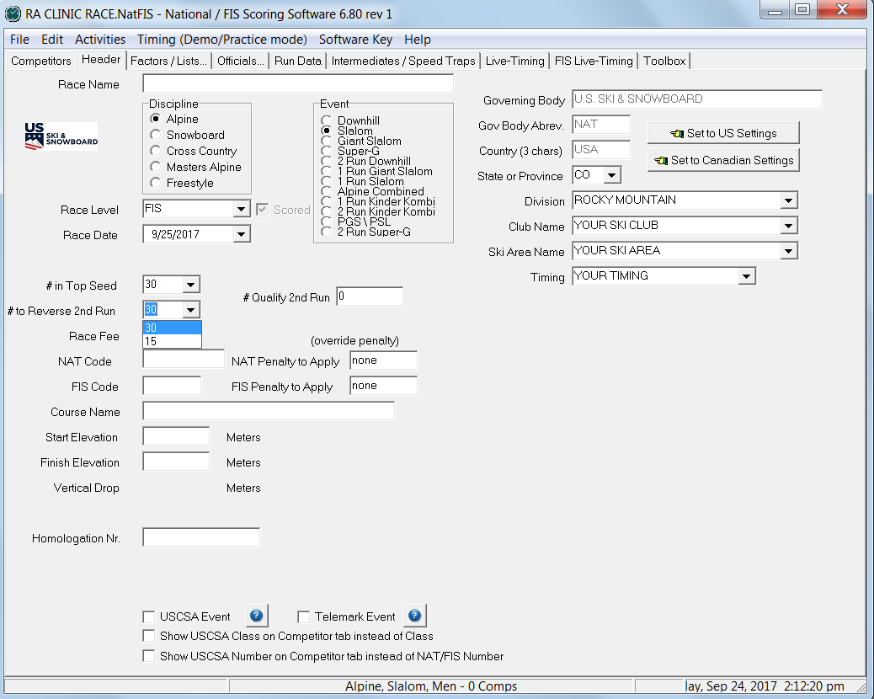
15 or 30: JURY MAY CHANGE #
How many racers will be reversed in the second run of a scored event.
30 is the default; Jury decision to change to 15 must be announced 1 hour prior to start of event!

Slide 51
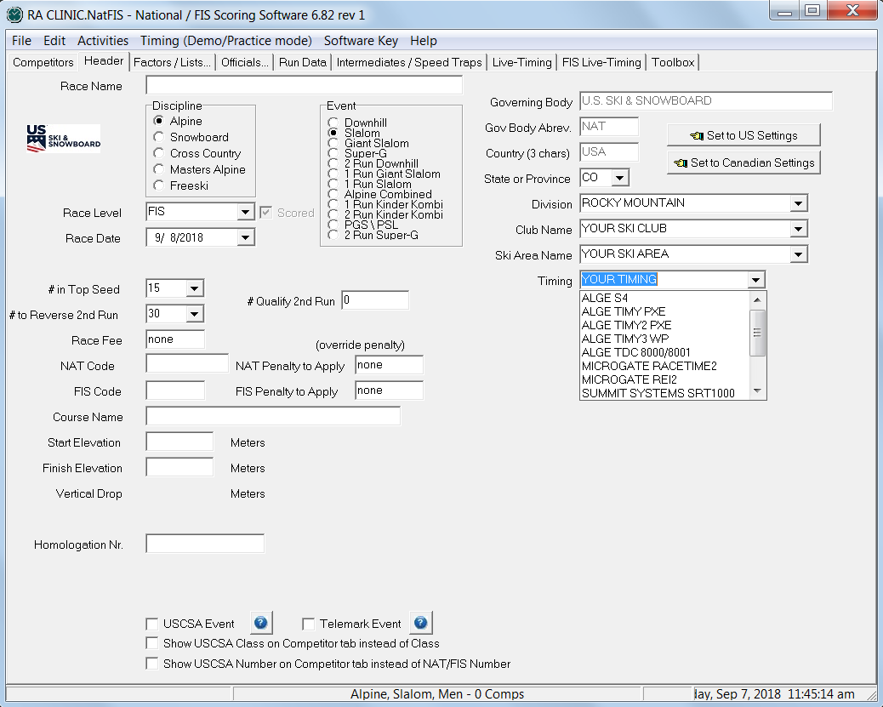
TIMING DATA: EQUIPMENT or TIMING COMPANY NAME
Select equipment being used or
key in name of
Timing Company.

Slide 52
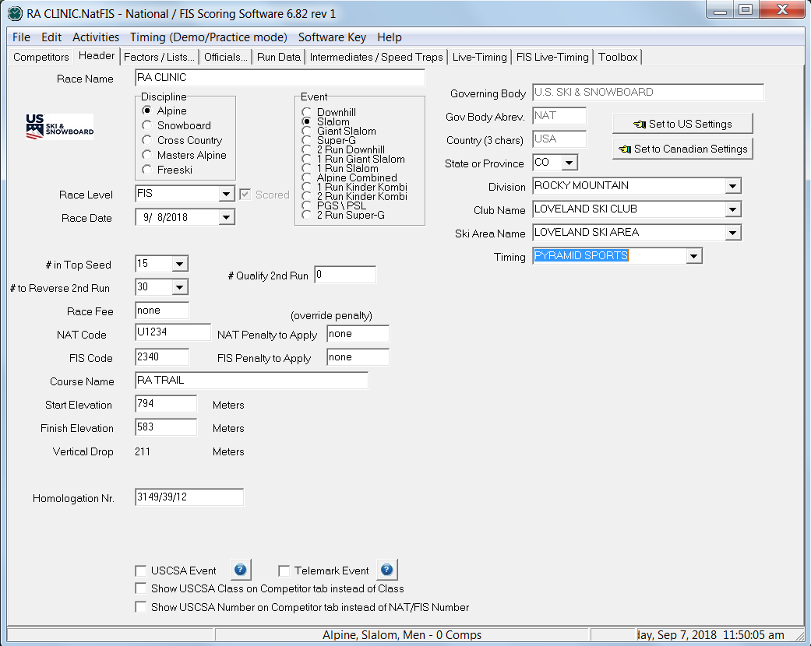
HEADER INFO COMPLETE
This is a completed header for a Men’s event.
Click “Alpine Slalom Men” to change race gender & enter data for Ladies’ event.

Slide 53
OTHER “CHANGE GENDER” OPTIONS
In addition to clicking on the event description/competitor count at bottom of screen, you can also change to an alternate gender by:
Keying “CTRL + S”, or
Selecting “FILE” / “Change Gender”
Any of these options allows you to establish one file for both genders and quickly move between the two.

Slide 54
MIXED-GENDER U10 / U12 EVENTS
Year-of-Birth (YOB) Seeding
Race File contains all competitors, regardless of gender
Competitors are sorted by YOB, regardless of gender
First-Run Start List is random sort within YOB
Subsequent Start Lists are prepared using TRS system
Results are processed by YOB, regardless of gender
Team Results may be produced
Men/Women Alpine List will be produced for download.

Slide 55
WHAT IS TRS a/k/a “BUTTERFLY”?
TRS or “totally random sort” is used for age-class events and is based on the first initial of the last name of the 3 individuals who developed it.
Start Lists are prepared as follows:
First event/run: start order is randomly drawn within each gender, class or group, e.g. Year-of-Birth
Second event/run (may be the same day or the following day): start order of first event/run is reversed within each gender, class or group
Third event/run (may be the same day or the following day): begins with the second half of the first event/run order in each gender, class or group, and continues with the second half of the first event/run order in each gender, class or group
Fourth race (may be the same day or the following day): the start order for the third event/run is reversed within each gender, class or group
NOTE: For individual events/runs, NPS/DNS/DNF/DSQ competitors start subsequent events/runs in their actual start positions.
Example:
Event/Run 1= 1,2,3,4,5,6,7,8,9,10
Event/Run 2= 10,9,8,7,6,5,4,3,2,1
Event/Run 3= 6,7,8,9,10,1,2,3,4,5
Event/Run 4= 5,4,3,2,1,10,9,8,7,6

Slide 56
CREATING AN EVENT DATABASE
There are 2 systems commonly used to create an event database:
1.) Use entry forms and key in competitors’ names to access the
competitors’ data as contained in the points list files:
Team Entry
FIS Entry (FIS events only)
2.) An online race registration system that creates a file for
downloading into software.
Regardless of the entry system you use:
YOU MUST VERIFY ALL COMPETITOR DATA AGAINST THE ORIGINAL SOURCE!

Slide 57
COMPETITORS’ ENTRIES
Entries in a non-FIS event are made by:
- Individuals using individual Entry Cards
- Teams using Team Entry Form
- On-line Race Registration Systems
Entries in a FIS event are made by:
- Teams (Nations) using FIS Entry Form
- On-line Race Registration Systems*
*(FIS Entry Form still required)

Slide 58
ONLINE RACE REGISTRATION SYSTEMS
If an OC chooses to use an Online Race Registration System, a file either in TXT or CSV format will be provided. After importing the file into the computer, the DM/RA:
Will be responsible for verifying competitors’ data
Will be responsible for updating points, if required
Will be responsible for updating competitor’s class, if required by Ski Up acceptance (non-FIS only)
Will be responsible for updating X-member (foreign) competitors’/officials’ nations
May have to combine data from individual files in order to create one “Competition Database”

Slide 59
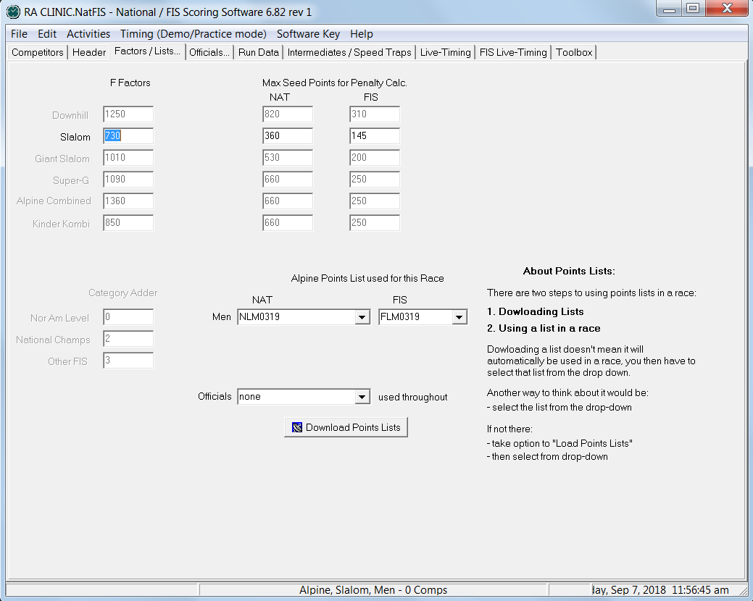
VERIFY YOUR POINTS LISTS DEFAULTS
Select “Competitors”
Select “Factors/Lists”
Category Adder is event specific; required only for FIS events.
(FIS List Cover Page)
Prior to inserting (keying in) competitors, verify that you are using the correct Points Lists for both genders:

Slide 60
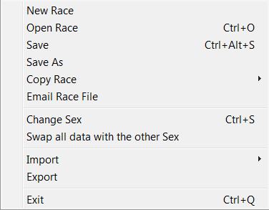
IMPORT A RACE REGISTRATION FILE
Select “FILE”
Select “IMPORT”;
Choose your source:
Comma, Tab, etc.
After you make your selection, you will be allowed to select file and download as required.

Slide 61
CREATE YOUR RA CLINIC RACE FILE
If you have correctly installed and selected either a U.S. Ski & Snowboard (Nat) or FIS Points List, you will now be able to create a race file that you can use for the rest of this clinic.
INSERT AT LEAST 35 RACERS
(Your Choice)

Slide 62
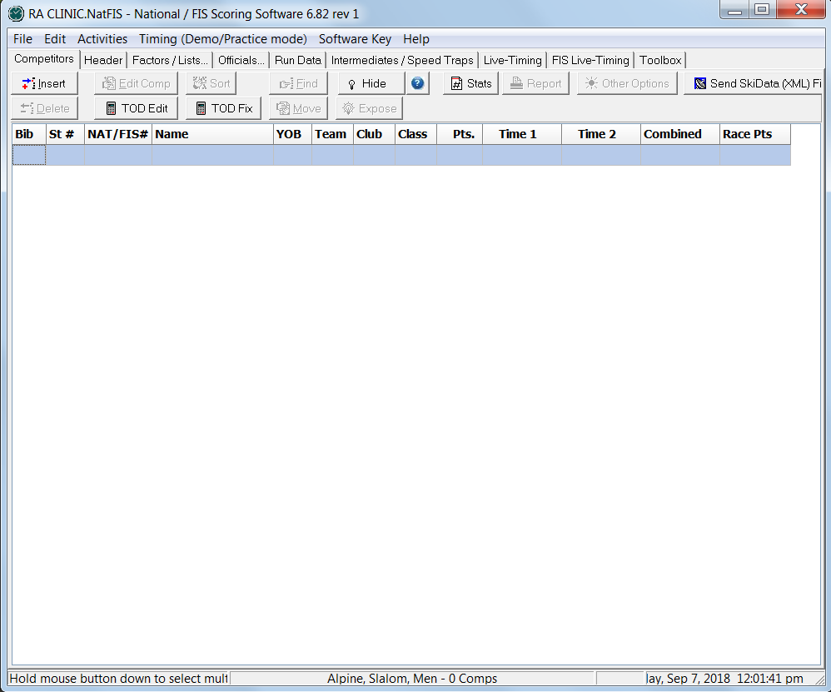
COMPETITOR INSERT
1.)
2.)
1.) Select “Competitors” & then
2.) Select “Insert”

Slide 63
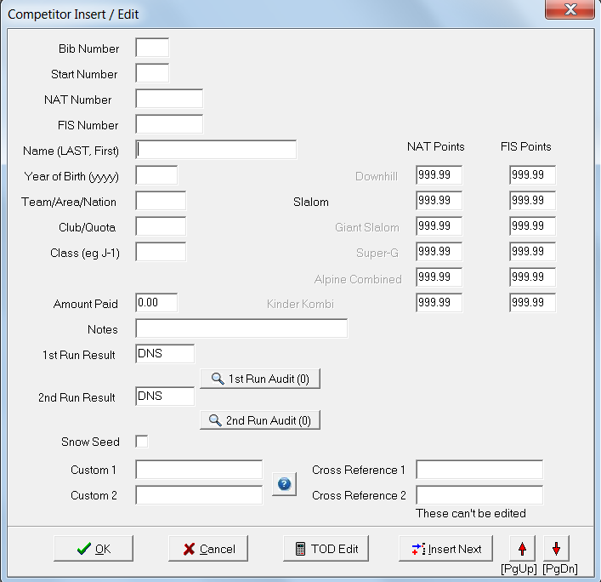
INSERTING COMPETITORS

Slide 64
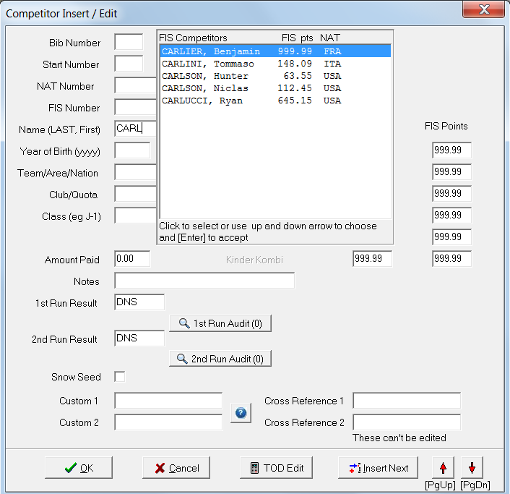
KEY IN FIRST FEW LETTERS OF LAST NAME & SELECT CORRECT COMPETITOR
Scroll down and select entered competitor
If unable to locate by last name, key in member’s U.S. Ski & Snowboard (NAT) number; for FIS event, key in FIS number
If more than 1 competitor has the same name, use NAT or FIS number to select correct competitor

Slide 65
EDIT or ADD ADDITIONAL COMPETITORS
For “Club” or “Quota”; do not use “Nation” field
“NOTES” used to indicate special info, e.g. entry comped, owes, SL only, etc.
If no information needs to be added, select “INSERT NEXT” for additional entries
Only Edit:
“CLASS” for Ski Up athletes or “NATION” for “X” members”

Slide 66
KEY IN & VERIFY OFFICIALS
Use same selection process – key in first few letters of last name & select correct official
Edit nation for “X members”, if required
Click on these icons to copy officials from the other gender’s file
Prior to printing any documents, verify names, membership status and certification & update status for all officials.
Software (NLO) listing does not verify an officials’ status! This must be verified on the U.S. Ski & Snowboard website.

Slide 67
Enter OFFICIALS
System is the same as for inserting competitors:
Key in a few letters of last name
Make selection from the Dropdown Box.
Only current members* are included in this file!
* You must verify certification and update status!

Slide 68
VERIFY ALPINE OFFICIALS’ CERTIFICATIONS & UPDATE STATUS
Membership data can be accessed through the “Public Tools” option on the U.S. Ski & Snowboard website. Key first few letters of last name, select correct official, verify certification and continuing education status (“Last Update Season”).
Must be a current national member, have appropriate certification and attend an Update for Continuing Education biennially!
Officials who are “PENDING” members must not be appointed.
Official’s Certifications
Last Update season: 2017/2018

Slide 69
KEY IN / VERIFY KNOWN RUN DATA
“RUN DATA” is where you key in 1st and/or 2nd Run information as well as Forerunners’ names:
Key in Last Name, First Name (capitalize first letters) & “TAB” (not “ENTER”). Forerunners’ membership must be verified on website!
USA is the default Nation.
To enter a different nation:
Open parenthesis, nation in all caps, close parenthesis, e.g. (CAN) & TAB.
Refer to Computer Input Information:
RA STUDY GUIDE SECTION 1, p.21

Slide 70
SET INTERMEDIATES & SPEED TRAPS
Use drop down menu to select number of Intermediates and Speed Traps
This information is critical for DH TRA, DH, SG & GS!
Verify this data with timing personnel. If they have the actual race file, they may wish to take responsibility for documenting this information.

Slide 71
VERIFY DATA & REGISTER RACE WITH U.S. LIVE-TIMING
Go to these sites to verify accuracy of uploaded data/reports
Follow directions to load event & resort logos already posted
Follow directions to load event & resort logos not posted
Great tool! If timing building does not have internet access, the RA can upload times at the end of each run. Event/area logos can either be selected from available list or uploaded for your selection.

Slide 72
POST, PRINT OR SAVE A REPORT
Select “REPORT”
Select type of Report
Report will automatically upload to live-timing
Option to print with graphics selected

Slide 73
TOP GRAPHIC
First Run Start List with graphics/zebra striping
Inserting Header & Footer Graphics is an option allowing display of Federation, Ski Area, Ski Club, sponsor logos, etc.
BOTTOM CENTER GRAPHIC BOTTOM RIGHT GRAPHIC

Slide 74
REPORT OPTIONS
Generate Report
Print or Save on Preview Screen
“Close” to return to software

Slide 75
OTHER L-T OPTIONS (After race is registered!)
Allows you to list all competitors, update competitor information or update times.
Allows you to post Messages:
“Start Delayed”, etc.
Also allows you to
Delete posted Reports
Verify accuracy of all postings & deletions!

Slide 76
FIS L-T OPTION (Posting on FIS L-T Site; please read/follow instructions)

Slide 77
A REPORT OPTION: SEED CARDS
If event requires “seed cards” (scored event), they can be quickly printed using this option.
Select “REPORT”
Select “OTHER”
Select “SEED CARDS”
Select size & data

Slide 78
OTHER OPTIONS
Some of the options available are:
Assigning bib/start numbers
Keying in Time of Day (ToD) information
Keying in elapsed times
Selecting/auto-assigning Snow Seed
Reloading Points List
Calculation of a Replacement Time: “EET”
You will need to access some of these options for your Clinic race.

Slide 79
AVAILABLE REPORTS & OPTIONS
Prior to your event, surf the software and discover the reports and options that are available for use.

Slide 80
RELOAD POINTS FROM POINTS LISTS Required when a new Points List becomes valid between events in a series or between DHT/DH race.
“RELOAD ALL DATA”: Reloads membership data, membership names, numbers, nations, etc., and may overwrite your additions; e.g. age class, corrected points, club, quota, notes and requires re-verification of your competition database.
“RELOAD ONLY POINTS”: only reloads the applicable Points List and is the preferred option to eliminate overwriting keyed data; e.g. quotas

Slide 81
ENTER 1ST RUN TIMES
In a real race situation, times are electronically transferred from the timing equipment to the result computer and race documents are then either generated by that computer, or the race or timing file is exported to the RA’s result computer via memory stick, email attachment or cloud transfer
However, you are here to learn, so:
Use “Electronic Time Recording Form – 1st Run”:
RA Study Guide Section 1, p. 26, key in 1st run data (times/status)
Use “Report by the Referee – 1st Run”:
RA Study Guide Section 1, p. 27, verify status of DNS/DNF/DSQ
competitors!
How many “options” are available that allow you to enter competitors’ times?

Slide 82
MANUAL TIME ENTRY
Times can be entered or edited in the 1st or 2nd Run Result field, as required

Slide 83
ADDITIONAL MANUAL ENTRY OPTIONS
“Enter Times (Elapsed)”
Select a run:
Enter your data:
“Enter Time of Day”

Slide 84
Time-Of-Day (TOD) EDIT OPTION

Slide 85
“FILE” OPTIONS
“Import” / “Export”: Send/retrieve specific data, e.g. Bib # + Name to T&C or retrieve Bib # + Time from T&C
“Save”: Save file in current location.
“Save As”: Save file with new name e.g. to create a new race where you require a new Live Timing registration.
“Copy Race”: Preferred option for copying a race file to a different location; this
option overwrites database of destination computer.

Slide 86
DATA ENTRY SYSTEMS (Using Race File)
If T&C staff uses “Copy Race” option and saves it to a thumbdrive
The RA uses software to open copied race & overwrites original file using “Save As” option
OR
If T&C staff attach correct “NatFis” race file and email it to RA as an attachment * or use “cloud storage” to transfer the file
The RA uses software to open downloaded attachment & overwrites original file using “Save As” option *
* When using company online services (and prior to race day), confirm you will be allowed to upload/download attachments!
You should always backup your race file. However, saving each action (1st Run Start, 2nd Run Start, Results, etc.) for each gender and under different names is strongly discouraged!

Slide 87
“email RACE FILE” OPTION
Please note:
This sends the race file as an attachment that can only be opened with Split Second software
This is NOT the method or format used for sending results to an autoscoring system, e.g. U.S. Ski & Snowboard, ACA or FIS!

Slide 88
email RACE FILE PROCEDURES
1.) Key in recipient – make
sure to include your email
address for verification
2.) Key in your information
3.) Enter your subject: Race Name
4.) Add your comments, if any
5.) Select “OK (send)”

Slide 89
1-800-GEOFF!
This is the option you use when all else has failed and Geoff Elder (Split Second creator & Master Wizard) needs to HELP!!!
Please respect this option; use only upon request from Geoff.

Slide 90
TRANSFER DATA: USING EXPORT/IMPORT
In “File”
1.) Select
“Export”
2.) Select
data you
want to
export.
It will be highlighted
Select your format
Use arrows to move selection to “export”;
click “OK” to continue
Import function is a reverse: Select “Import”, select
“Fields to Import” & click “OK”

Slide 91
ENTER 1ST RUN DATA
You have to return to this page to key in: Weather and Gate Counts (Temps are “air” temps at start area & finish area at the beginning of the race.
If you are given temps in Fahrenheit, key in ##F and Celsius conversion will be calculated automatically.

Slide 92
EDIT A COMPETITOR: KEY IN DSQ
If a racer is given a provisional 2nd Run Start and 1st Run DSQ is upheld, DSQ must be entered in the run in which it occurred

Slide 93
ToD EDIT: Edit Times or Change Status
Competitor’s status can also be changed on this page; however it does not allow for input of infraction data: gate # or rule #.
This information is required on Official Results!

Slide 94
WHAT IS REQUIRED?
Key in GATE # where infraction occurred or RULE # violated
Overwrite assigned
time by keying DSQ
Remember to “TAB” (not “ENTER”) to exit data fields

Slide 95
RECORDING A “NPS” SITUATION: NON-FIS and FIS EVENTS
Due to rule(s) violation(s), athlete not permitted to start (NPS)…this could apply to either run of a 2-run event
Athlete’s status is recorded by the Start Referee as “Not Permitted to Start” (NPS); reason must be stated
Example: Note suggestion to insert “name”
“NPS” is noted in of Report by the Referee as required
Example:
Applicable rule number must be noted for results (Procedure will be similar as for entering DSQ rule #)
Software allows for “NPS” designation

Slide 96
BLOCK EDIT
Use “shift” key to scroll/select group
“Block Edit” replaces “Edit Comp” on screen
Edits will apply to entire block

Slide 97
BLOCK & SORT
Use “shift” key to scroll/select group
“Sort” is selected (behind menu)
Group can be sorted to your parameters

Slide 98
MOVE
Select athlete
Select “Move”
Note WOOLSON was moved before KELLEY

Slide 99
HIDE / EXPOSE
“Hide” a group of competitors: Block the group you want to hide & select “Hide”. They do not show on lists but remain in database
“Expose” the group by selecting “Expose”. The following message appears:
Select “OK” to continue. Field can be resorted to place competitors in preferred order

Slide 100
DOCUMENTS AFTER 1ST RUN
After all 1st Run Data has been verified, print the following documents:
1st Run Result
2nd Run Start List: Prior to printing this document make sure that you have selected the correct amount of racers that will be flipped for the second run in a scored event:
15 or 30
Verify whether or not 1st Run NPS, DNS, DNF & DSQ competitors will be allowed to take a 2nd Run. If so, verify they were inserted in accordance with rules/procedures for level of event.
For non-scored events, please verify/default to Region/Division 2nd Run Start Procedures
If you are unsure of any of the procedures, ask for HELP!

Slide 101
ENTER/VERIFY 2ND RUN DATA
Enter 2nd run gate counts
Verify Start Times
Verify weather/course data entered
Refer to Computer Input Information:
RA STUDY GUIDE SECTION 1, p.29

Slide 102
ENTER 2ND RUN TIMES
Use “Electronic Time Recording Form – 2nd Run”:
RA Study Guide Section – Section 1, p. 30,
key in second run times for each competitor
Use “Report by the Referee – 2nd Run”:
RA Study Guide Section , p. 31,
verify DNS/DNF/DSQ information!

Slide 103
DOCUMENTS AFTER 2ND RUN
After all 2nd Run Data has been verified, print the following documents:
Unofficial Results
Official Results: Prior to printing this document, verify that you do not have to input a Penalty override
Penalty is overridden when
1.) it calculates below the minimum allowed,
2.) when a non-FIS event does not meet minimum
standards or
3.) when a Penalty must be manually calculated
FIS race with a calculated penalty of 3.00
Minimum Penalty applied and will overwrite calculated Penalty

Slide 104
What is an “applied Penalty”?
The Penalty for “scored events” is calculated by the software and is based on known criteria: event Factor, competitors’ seed points, competitors’ times, etc.
For some events, a minimum Penalty must be applied:
non-FIS races that do not meet minimum technical standards,
Penalties that calculate below accepted minimums,
Penalties that must be manually calculated.
For these few instances, keying in an “applied Penalty” overrides the computer’s calculation.
If no override is required, no data needs to be keyed in at this location on the Header page.

Slide 105
RESULTS & PENALTY: Verify accuracy prior to transmission of XML file
Print results by class (for awards)
Prior to printing signature copy, verify all data: header, race code/codex, date, etc.
Verify accuracy of Penalty (if required)
Select and print Official Results in format required by level of event
If all result formats are not visible, you can slowly pull the option box to enable display. If this does not fix the problem, DPI (dots per inch) adjustment may be required (Control Panel/Display)

Slide 106
RESULT OPTIONS – ORIGINAL FORMAT
NON-FIS EVENT
FIS EVENT
Bib numbers for NPS, DNS, DNF, DSQ competitors noted on Report by the Referee must agree with the race results (paper or XML). Please print results as follows:
Select print option: “Start number on results” if first-run start numbers agree with actual bib numbers.
Select print option: “Bib number on results” if you do not have a complete set of bibs or if you have inserted a bib number out of running order.

Slide 107
RESULT OPTIONS – GRAPHICS FORMAT
Graphics format allows for either NAT or FIS Unofficial or Official Results

Slide 108
RACE DAY QUESTIONS
Why is data backup critical?
What is the difference between non-scored events & scored events? e.g. Start Lists & Results
Do I need 2 separate race files? One for each gender?
How do I use today’s event to create tomorrow’s event?
After the first run, a racer is given a provisional second run start that is not accepted by the Jury. Where do I key in the DSQ information?
I called the HELP DESK and they’ve requested I send the race file! THE WHAT? WHERE IS IT? HOW DO I DO IT?
Software keeps “freezing”. WHY?
Why do I have to verify all data against the original source: U.S. Ski & Snowboard for non-FIS data & FIS for FIS data.
Why can’t I download the FIS List directly from the FIS website?
I downloaded a “corrected” Points List, but the Points haven’t been corrected. What do I have to do?

Slide 109
REPLACEMENT TIME (EET)
Calculation of a Replacement Time (also known as an Equivalent Electronic Time) is normally the responsibility of the Chief of Timing or his/her assistant.
However, due to force majeure, the assistance of the RA may be required.

Slide 110
SOFTWARE’S “EET” TOOL found in “OTHER OPTIONS”
NOTE: Calculation requires comparison of start or finish System A time-of-day to System B or manual time for 10 competitors preceding missed time.

Slide 111
HINTS!
DO NOT use Forerunners’ times
Calculation is based on Time-of-Day data so DNF competitor’s start times can be used
DO NOT wait until race day to learn how to use this or any of the many other useful tools provided by this or any other software!
If time permits, review “REPLACEMENT TIME - EET” power point presentation.

Slide 112
VERIFICATION ITEMS
Prior to submitting your results XML file, you must verify all keyed data.
The software may prepare a “Transmittal Report”; it contains data you have keyed into your database.
Print the “Transmittal Report” and use it to verify the data it contains…especially useful for verifying Officials names.
Verify/Edit “Nation” for any U.S. Ski & Snowboard “X members”
If an error is found, rekey the data, reprint and reverify the data.
Transmittal Report, if available, remains in the OC event file.

Slide 113
CREATING/SENDING“XML” FILE File can be created/sent from either area:
“Activities”

Slide 114
WHAT IS AN “XML” FILE?
“XML” file is a data string file that contains all the information related to the race: Header, Officials, Forerunners, Weather, Competitor Data, Times, etc. Its format allows for auto-scoring.

Slide 115
SAVING & SENDING AN XML FILE
Save to Desktop or other easily identified location.
File is then submitted as an email attachment.

Slide 116
REVIEWING THE XML FILE
When viewing the XML file:
Select major areas, e.g. race code/codex #’s, penalty, if applicable, winner + his time, DSQ’s, etc., and verify their accuracy
If errors are found, return to the applicable input page and make corrections
Re-create & re-verify XML file
Making corrections to keyed data is the recommended method. Improper editing of an XML file can damage the XML file and cause issues.

Slide 117
SAVED & LOCATED: Now What Do I Do With It?
Create email, attach and send one of the following, as required by level of event – note differences in formats:
Non-FIS Event - alpineresults@usskiandsnowboard.org
(Use non-FIS race code as subject of email:
Alpha character + 4 #’s: U0354)
FIS Event - alpineresults@fisski.ch
alpineresults@usskiandsnowboard.org
(Use Nation + FIS codex # as subject of email: USA1759)
Attach only ONE XML file per transmission!
U.S. Ski & Snowboard and FIS will each respond with either an acceptance or error report.
If response delayed, wait…DO NOT transmit multiple times!
If “Include Hard Copy” not deselected, do not attach the hard copy!

Slide 118
emailING XML FILE FROM THE SOFTWARE
Use only after verification of accuracy.
Ski area and/or club firewalls may not allow this option.
NOTE: U.S. Ski & Snowboard will accept email transmission.

Slide 119
HOW IS THE XML FILE USED?
Submission of race result files in XML format is required for all U.S. Ski & Snowboard* and FIS events
Electronic submission of race result files in XML format simplifies result processing
When an XML result file is submitted in the correct format to the correct auto-scoring system, the race results are quickly posted to the applicable websites
Auto-scoring systems allow U.S. Ski & Snowboard and FIS to publish updated Points Lists at more frequent intervals
Updated Points Lists allow seeding that more accurately portrays an athlete’s ability
* Transmittal of xml file for non-scored events is required if the OC wants them posted on the U.S. Ski & Snowboard website

Slide 120
SUGGESTIONS
Prior to your first event:
Review both sections of the Race Administration Study Guide
Review all software options
Practice all event-related software procedures
Establish contact with an experienced RA a/k/a (“Dial-A-Friend”), who is willing to take the time to help you solve issues that may occur!

